Slide 1
Security
Outline
  Encryption Algorithms
  Authentication Protocols
  Message Integrity Protocols
  Key Distribution
  Firewalls

Slide 2
Overview
Cryptography functions
  Secret key (e.g., DES)
  Public key (e.g., RSA)
  Message digest (e.g., MD5)
Security services
  Privacy: preventing unauthorized release of information
  Authentication: verifying identity of the remote participant
  Integrity: making sure message has not been altered
Security
Cryptography
Security
algorithms
services
Secret
Public
Message
Privacy
Authentication
Message
key
key
digest
integrity
(e.g., DES)
(e.g., RSA)
(e.g., MD5)

Slide 3
Secret Key (DES)
Plaintext
Plaintext
Encrypt with
Decrypt with
secret key
secret key
Ciphertext

Slide 4
64-bit key (56-bits + 8-bit parity)
16 rounds
Each Round
Initial permutation
Round 1
L
i
–
1
R
i
–
1
F
K
i
Round 2
56-bit
+
key
…
L
R
i
i
Round 16
Final permutation

Slide 5
Repeat for larger messages
Block
Block
2
Block
3
Block
4
1
IV
+
+
+
+
DES
DES
DES
DES
Cipher
1
Cipher
2
Cipher
3
Cipher
4

Slide 6
Public Key (RSA)
Plaintext
Plaintext
Encrypt with
Decrypt with
public key
private key
Ciphertext
Encryption & Decryption
  c = m^{e}mod n
  m = c^{d}mod n

Slide 7
RSA (cont)
Choose two large prime numbers p and q (each 256 bits)
Multiply p and q together to get n
Choose the encryption key e, such that e and (p - 1) x (q - 1) are relatively prime.
Two numbers are relatively prime if they have no common factor greater than one
Compute decryption key d such that
  d = e⁻¹mod ((p - 1) x (q - 1))
Construct public key as (e, n)
Construct public key as (d, n)
Discard (do not disclose) original primes p and q

Slide 8
Message Digest
Cryptographic checksum
  just as a regular checksum protects the receiver from accidental changes to the message, a cryptographic checksum protects the receiver from malicious changes to the message.
One-way function
  given a cryptographic checksum for a message, it is virtually impossible to figure out what message produced that checksum; it is not computationally feasible to find two messages that hash to the same cryptographic checksum.
Relevance
  if you are given a checksum for a message and you are able to compute exactly the same checksum for that message, then it is highly likely this message produced the checksum you were given.

Slide 9
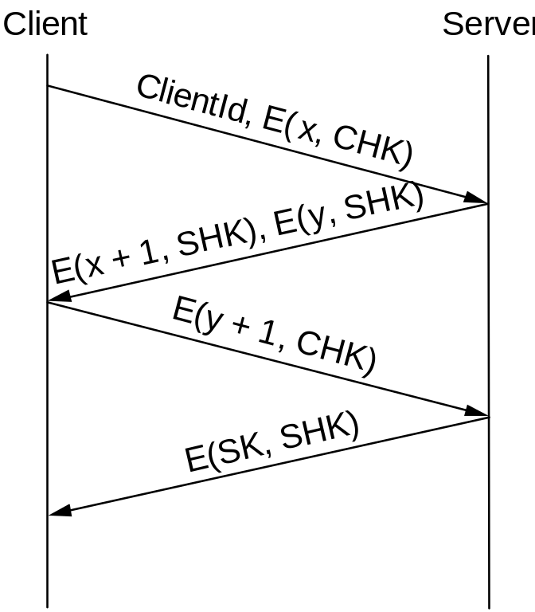
Authentication Protocols
Three-way handshake

Slide 10
Trusted third party (Kerberos)
S
A
B
A
,
B
E
((
T
,
L
,
K
,
E
((
T
B
),
K
,
L
,
K
A
),
,
A
),
K
)
B
E
((
A
E
((
,
T
),
T
,
L
,
K
),
K
,
A
),
K
)
B
+ 1,
K
)
E
(
T

Slide 11
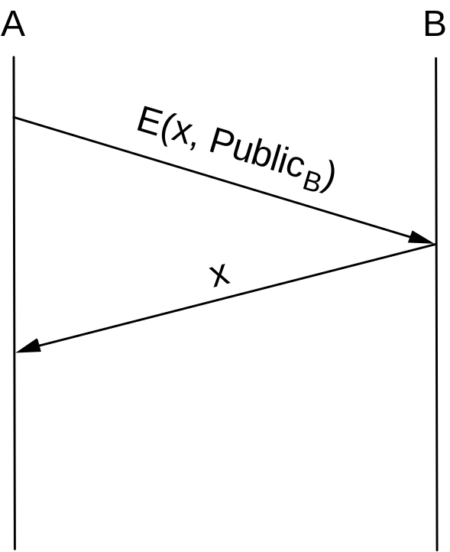
Public key authentication

Slide 12
Message Integrity Protocols
Digital signature using RSA
  special case of a message integrity where the code can only have been generated by one participant
  compute signature with private key and verify with public key
Keyed MD5
  sender: m + MD5(m + k) + E(k, private)
  receiver
    recovers random key using the sender’s public key
    applies MD5 to the concatenation of this random key message
MD5 with RSA signature
  sender: m + E(MD5(m), private)
  receiver
    decrypts signature with sender’s public key
    compares result with MD5 checksum sent with message

Slide 13
Key Distribution
Certificate
  special type of digitally signed document:
    “I certify that the public key in this document belongs to the entity named in this document, signed X.”
  the name of the entity being certified
  the public key of the entity
  the name of the certified authority
  a digital signature
Certified Authority (CA)
  administrative entity that issues certificates
  useful only to someone that already holds the CA’s public key.

Slide 14
Key Distribution (cont)
Chain of Trust
  if X certifies that a certain public key belongs to Y, and Y certifies that another public key belongs to Z, then there exists a chain of certificates from X to Z
  someone that wants to verify Z’s public key has to know X’s public key and follow the chain
Certificate Revocation List

Slide 15
Firewalls
Rest of the Internet
Firewall
Local site
Filter-Based Solution
  example
    ( 192.12.13.14, 1234, 128.7.6.5, 80 )
    (*,*, 128.7.6.5, 80 )
  default: forward or not forward?
  how dynamic?

Slide 16
Proxy-Based Firewalls
Problem: complex policy
Example: web server
Solution: proxy
Design: transparent vs. classical
Limitations: attacks from within
Remote
company
user
Internet
Firewall
Company net
W
eb
server
Random
external
user
External
Firewall
Local
client
Proxy
server
External HTTP/TCP connection
Internal HTTP/TCP connection

